Slide 1


Hand Landmark Detection
Hand Landmark Detection Experiments
Aug 4th, 2023
To. professor

Slide 2
Hand Landmark Detection
Index_
1. Introduction of the added data for the additional experiment.
2. Data preprocessing
3. Comparison the results

Slide 3


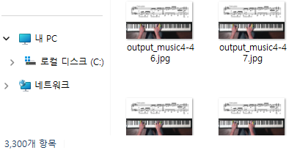
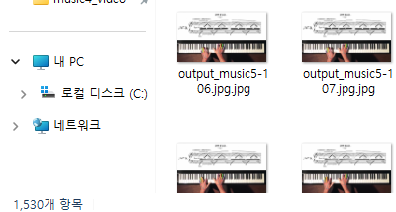
1. Introduction of the added data for the additional experiment.
There are 3,300 of music4_output files and 1,530 of music 5_output files obtained through data preprocessing.
The way how to preprocess lots of original data is a handwork.
1

Slide 4
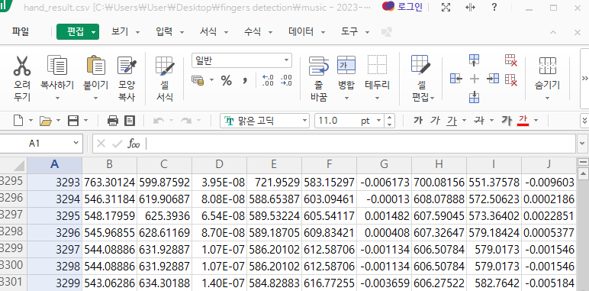
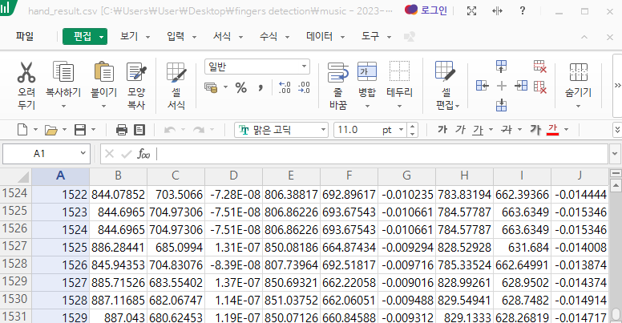
1. Introduction of the added data for the additional experiment.
The image below is the result of the hand_result.csv file obtained through preprocessing.
music4: 3,300 files
music5: 1,530 files
A column will be deleted.
A column will be deleted.
* if it does not have the same name as the preprocessed file among the original images,
delete it and run the mediapipe code again to create the hand_result.csv file.
2

Slide 5
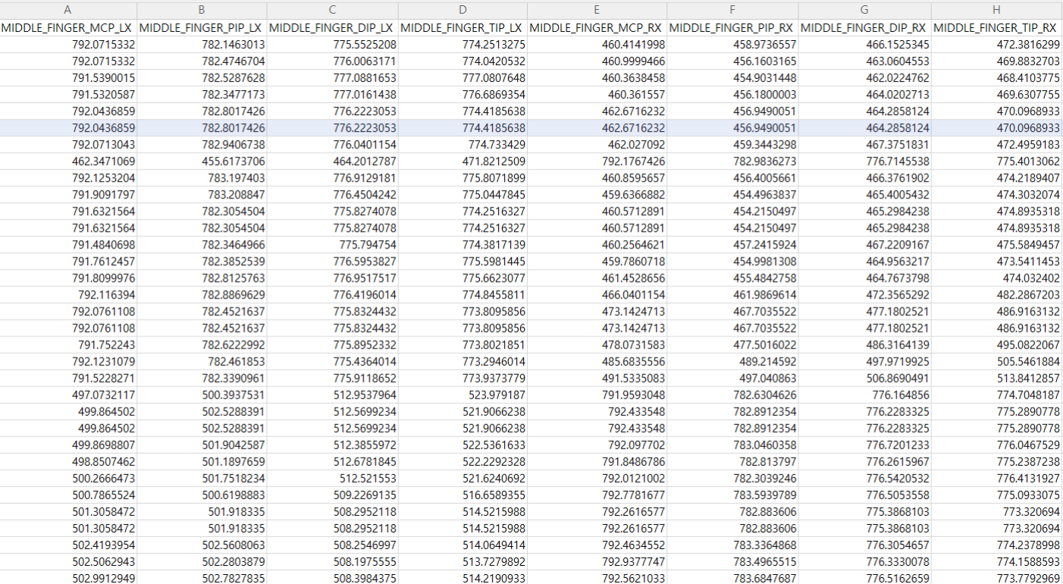
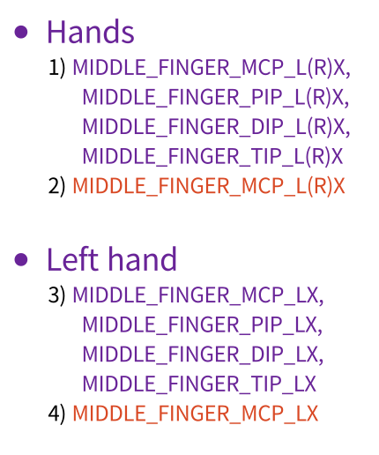
2. Data preprocessing
3

Slide 6

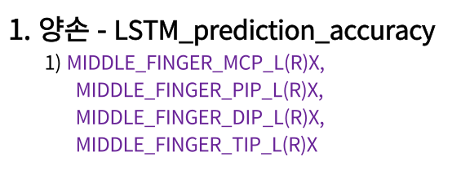
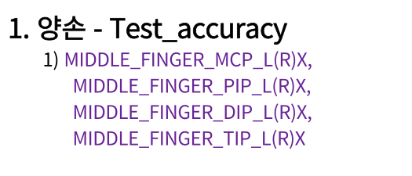
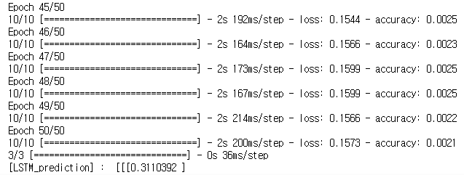
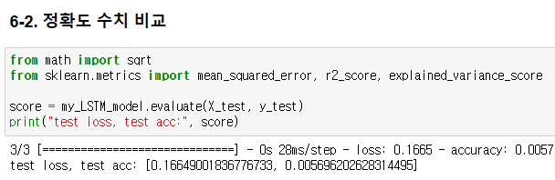
3. Comparison the results
4

Slide 7
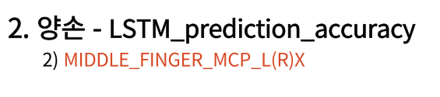
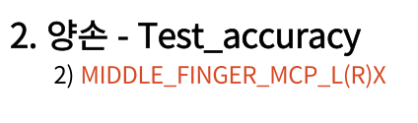

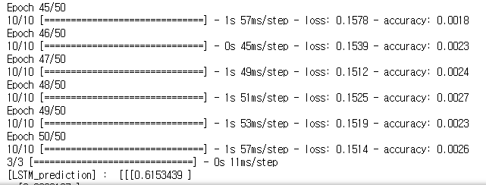
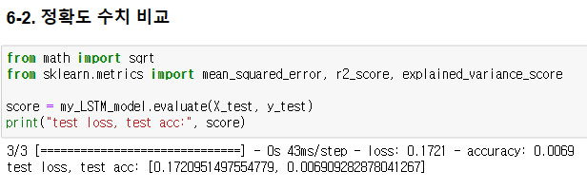
3. Comparison the results
5

Slide 8
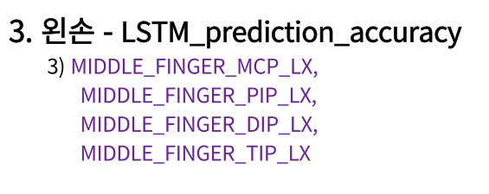
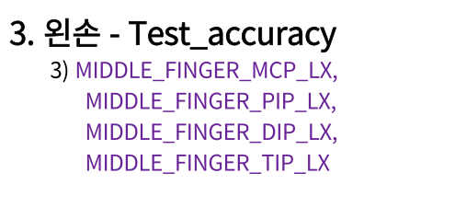
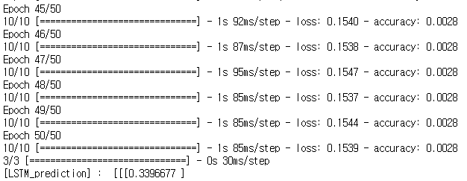
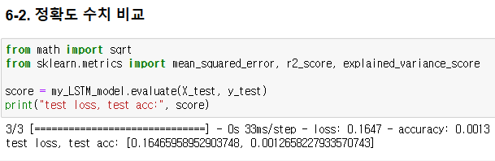
3. Comparison the results
6

Slide 9
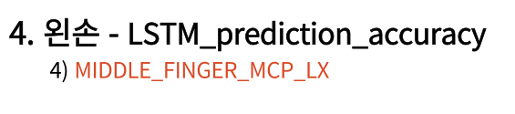
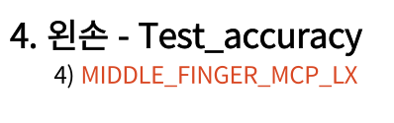
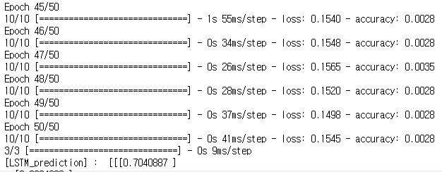
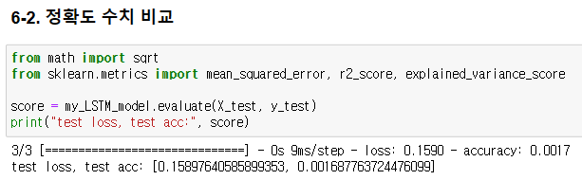
3. Comparison the results
7

Slide 10





3. Comparison the accuracy
train_acc: 0.0021
train_loss: 0.1573
test_acc: 0.0057
test_loss: 0.1665
train_acc: 0.0026
train_loss: 0.1514
test_acc: 0.0069
test_loss: 0.1721
train_acc: 0.0028
train_loss: 0.1539
test_acc: 0.0013
test_loss: 0.1647
train_acc: 0.0028
train_loss: 0.1545
test_acc: 0.0017
test_loss: 0.1590
8

